Slide 3
El poder de los powers
PoweView, PowerPivot, PowerMaps
SharePoint PowerView

Slide 4







ING. ANDRES FELIPE ROJAS
MVP SHAREPOINT SERVER
@arojaspa
andres.rojas@geeks.ms
http://arojaspa.blogspot.com
arojaspa
@sharecol
sharecol@outlook.com
http://www.sharecol.com

Slide 5

VERÓNICA BAS
BI SUPPORT ENGINEER MICROSOFT
Veronica.bas@microsoft.com
http://blogs.msdn.com/b/brushstrokes/
veronicabas

Slide 6
Agenda
Introducción a Power View
Características de Power View
Demo

Slide 7
Introducción a Power View

Slide 8


Introducción a Power View
POWER VIEW
Experiencia de diseño altamente visual
Interactividad enriquecida por metadatos
Presentation-ready a toda hora
EMPOWER USERS
END USER ALERTING
Reportes Operacionales
Alertas intuitivas
Alertas auto administradas a través de SharePoint
INTELIGENCIA PROACTIVA
HABILITADO COMO UNA APLICACION DE SERVICIO EN SHAREPOINT
Built-in scale-out para RS Service Apps
SharePoint Cross-farm reporting
backup & recovery, ULS logging, PowerShell etc.
INCREMENTO DE EFICIENCIA
Managed Self Service BI – Corporate BI

Slide 9
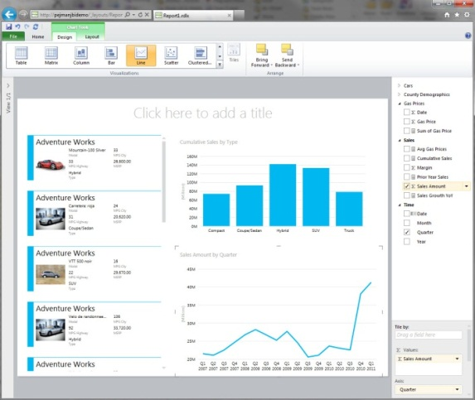
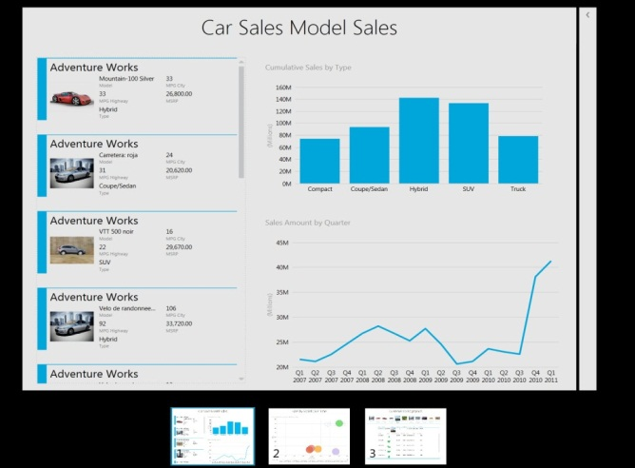
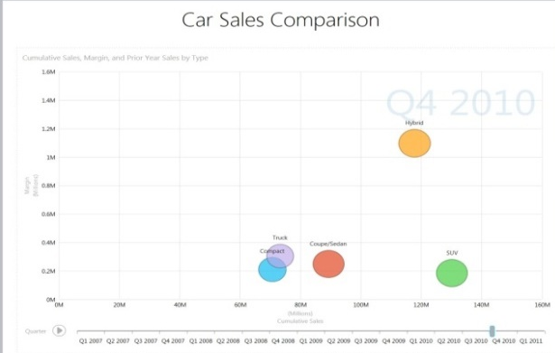





QUE ES Power View?
Desde la edición a la presentacion en algunos clics
Cambiar los datos y el diseño en pocos clics
Colaboración con integración completa
Comparte reportes dinámicos de manera rápida y fácil
Cross Browser & Platform
Managed & Discoverable

Slide 10

SQL Server 2012 Power View
EXPERIENCIA DE DISEÑO ALTAMENTE VISUAL
Interactivo, Compartir informacion y edición basada en web
Familiar: Usa Patrones de diseño de Microsoft Office
Poderoso y Fexible

Slide 11
SQL Server 2012 Power View
INTERACTIVIDAD ENRIQUECIDA POR METADATOS
Integración completa con PowerPivot y el modelo semántico de BI
Mayor conocimiento a través de consultas inteligentes y poderosas
Tendencias y comparaciones animadas

Slide 12
SQL Server 2012 Power View
PRESENTATION-READY
A TODA HORA
Presentación Interactiva de información
Entregar y colaborar a través de SharePoint
Modo de presentación de pantalla completa

Slide 13
Power View para todos los Usuarios
Sophisticated Design Environment
Report Viewer Controls
Rich Design Capabilities
Developers
Productive Authoring
Re-use of insights
Flexible layout
IT Pros
Power Users
Visual data representation
Highly Interactive
Rich Presentation
End Users
Report Designer
Report Builder
Power View
Embedded
Operational
Business

Slide 14




Arquitectura SharePoint para Power View
SharePoint Farm
Power View client
Web Front End
App Server
SSDT BISM Model
SSRS Addin for SharePoint
RS Shared Service
AS Server
PowerPivot
System Service
PowerPivot
Web Service
Excel PowerPivot
Heterogeneous
Data sources
Analysis Services SP Integrated

Slide 15


CONSTRÚYALO EN LO QUE CONOCE
Familiar
Colaborativo
Administrado

Slide 16
Características de Power View

Slide 17
Algunas características de
Power View 2012
Model Explorer and Field list for model navigation and data region structure
Automatic Grouping improvements
Multiple views in a single report
Presentation mode with interactivity
Canvas, ribbon, application infrastructure
Graceful recovery from model changes
Filter pane supports lists, measure slider, calendar, and advanced mode
Data region conversions
Common chart types, chart titles, legend, axes, configure chart, chart series
SharePoint integration (launch from doc lib, manage, preview, Power Pivot gallery)
Interactivity: highlight, cross filter, play axis, popup, transition animations, bubble trails…
Table & Matrix
including subtotals, totals, blocking
Embedded image support
Non Measures as Measures
Tab Strip and Cover Flow Tiles for data navigation
Sorting
Textboxes with rich text formatting
Motion charts
Show All
Small multiples layout
Measures as Non Measures
View and data region level filtering with slicers and filter pane
Export to PowerPoint
Drag and Drop to Canvas

Slide 18
El valor de DAX
(data analysis expressions)
Included in Power View by Default
Power View with DAX
Count &
Distinct Count
Sum
Min & Max
Average
Addition and Subtraction
Ratios
Power View with DAX
Time Intelligence
Rank
Inventory Calculations
Standard Deviation & Variance
Text
Functions
Define Your Own Context

Slide 19
Power Query Power View Power Map SharePoint PowerPivot
DEMO
Impacto del Ébola en el mundo

Slide 20
Q&A

